Slide 1
Bila Tserkva National Agrarian University
National Dendrological Park "Sofiyivka" of the National Academy of Sciences of Ukraine
Uman National University of Horticulture
EXPERIENCE OF USING DIFFERENT PLANTS
IN URBAN ECOSYSTEMS
Speakers: Ishchuk Liubov, Doctor of Biological Sciences, Professor
Hrabovyj Volodymyr, Ph.D. in Biological Sciences, Senior Researcher
Ishchuk Halyna, Ph.D. in Agricultural Sciences, Associate Professor
Didenko Inna, Ph.D. in Biological Sciences, Researcher

Slide 2
2
Global trends are focused on the maximum reproduction of natural landscapes within cities through the planting of native plant species. According to S. Polomanyi (2020), among the primary challenges faced by nearly every modern city in the coming decades will be the ability to survive during climate catastrophes and withstand competition in the struggle for urban comfort. Adapting urbanized systems to the challenges of nature will be aided by resilient landscapes and nature-oriented solutions (Riabyka, et al, 2021; Ishchuk, & Ishchuk, 2022). One of the directions for bringing urban ecosystems closer to sustainable natural landscapes is the replacement of lawns with ornamental grasses of native species that are most resistant to biotic and abiotic factors of the urban environment (Pol', 2021; Ishchuk, & Ishchuk, 2021; Ishchuk, et al. 2022).

Slide 3
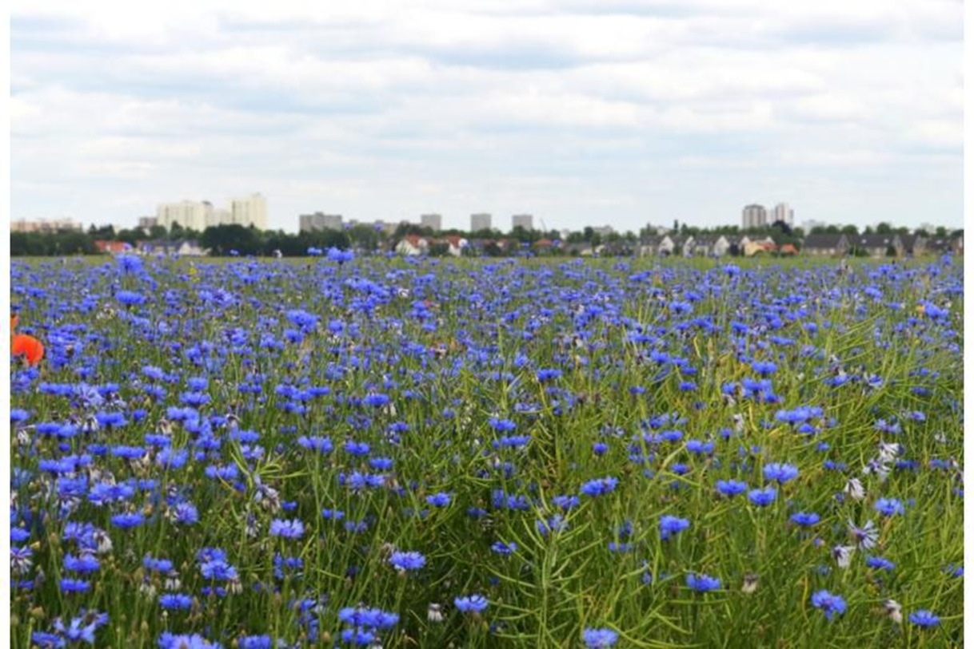
3
The experience of Western European cities is worth spreading, where flower beds and perfectly manicured lawns are being replaced with flower meadows. The Berlin project named "Closer to Nature" has been ongoing for five years, initiated by activists from the Nature and Biodiversity Conservation Union of Germany (NABU). The Berlin government has allocated almost 1.5 million euros to create over 50 patches of wildflower meadows and fields with field flowers, along with their maintenance (Pysans'ka, 2021). http://www.golos.com.ua/article/347969

Slide 4
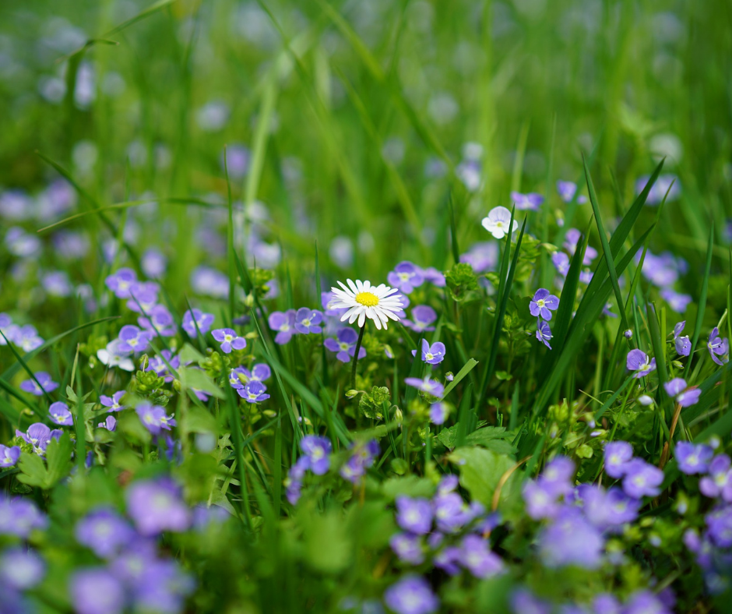
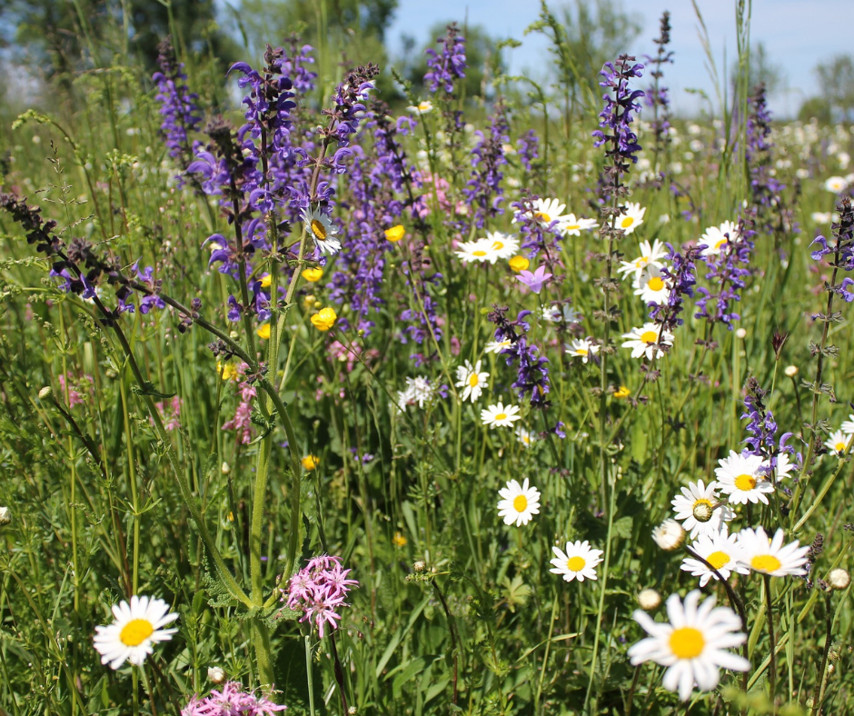
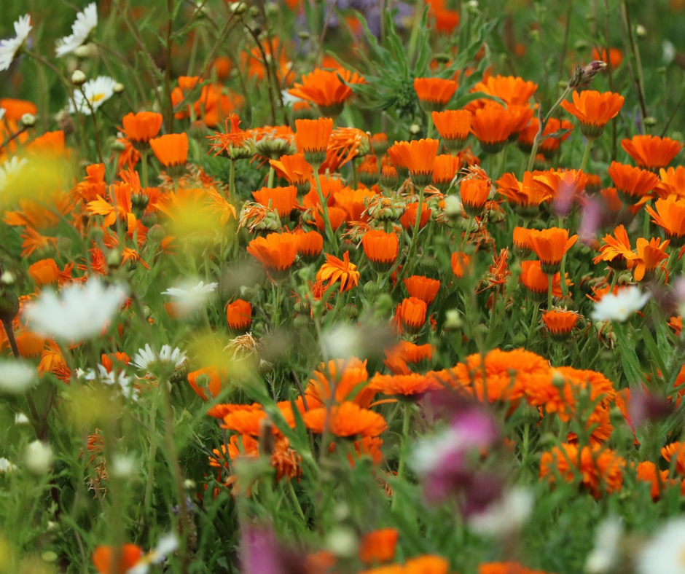
4
Urban blooming meadows of Erfurt
The use of flower meadows in urban landscaping is widely adopted in Hamburg, where the trend originated, as well as in Berlin and Erfurt. In particular, in Erfurt in 2021, additional "flower strips" covering about 16 hectares were planted along the city roads. For this purpose, 11 local farmers allocated their lands for blooming strips in collaboration with the city authorities, where species and varieties like Tagetes L., Echinacea Moench., Alcea rosea L., Papaver rhoes L., and others were sown (Pol', 2021) URL: https://ecoclubrivne.org/miski_luky.

Slide 5
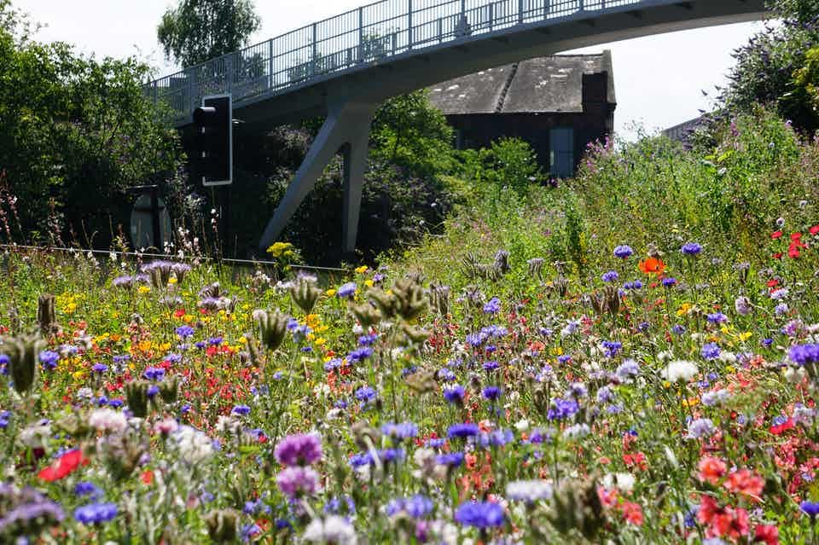
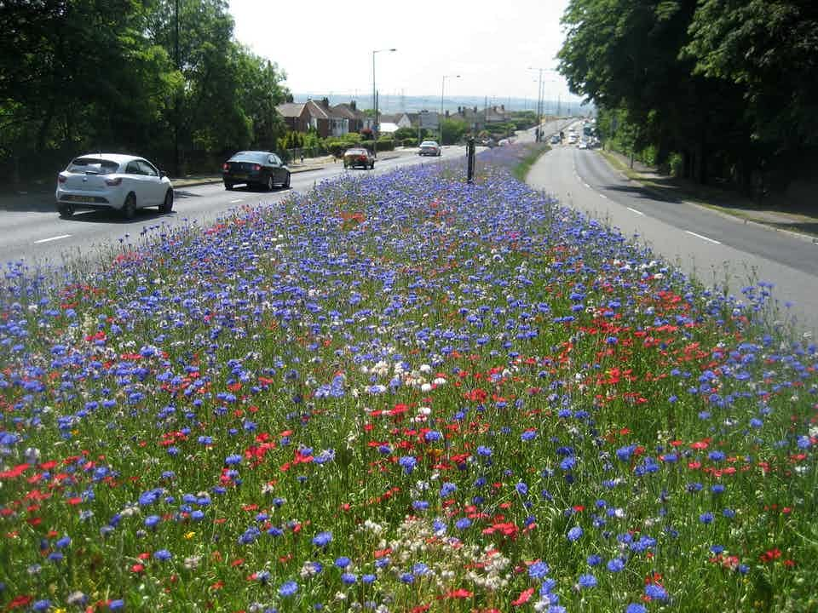
5
Flowering meadows in Great Britain
Similar research on the implementation of native perennial grasses in urban ecosystems was conducted by a group of scientists in the United Kingdom (Hoyle, et al., 2017).
Hoyle, H., Jorgensen, A., Warren, P., Dunnett, N., &Evans, K. “Not in their front yard” The opportunities and challenges of introducing. perennial urban meadows: A local authority stakeholder perspective Urban Forestry and Urban Greening, 2017. 25, 139-149. https://doi.org/10.1016/j.ufug.2017.05.009

Slide 6
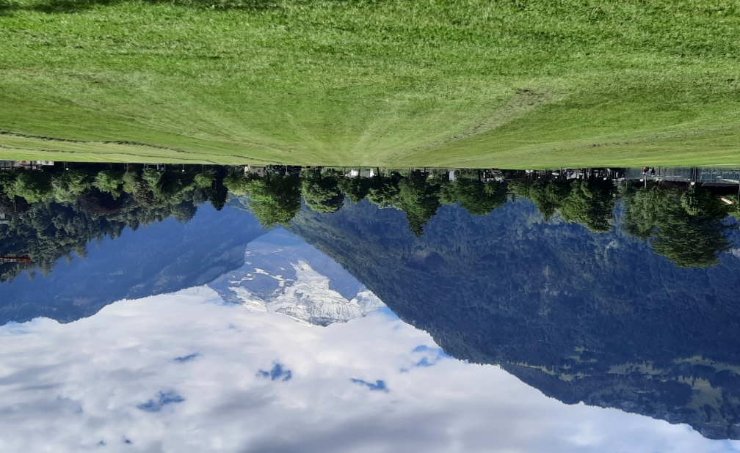
6
Heimette Park with native vegetation in the center of the resort town of Interlaken (Switzerland).
In the Swiss resort town of Interlaken, the Heimette Park with an area of 14 hectares is located along the Höheweg boulevard, where undisturbed herbaceous vegetation is carefully preserved.

Slide 7
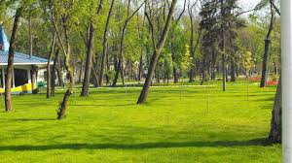
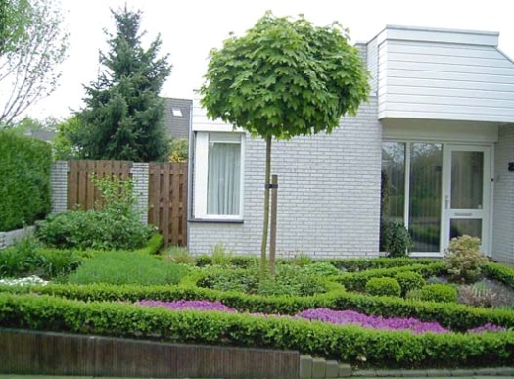
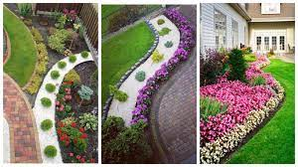
7
In Ukraine, the classical, still Soviet approach to landscaping has persisted, involving completely mowed lawns, precisely trimmed hedges, and lush flowerbeds with specially cultivated flowers. However, as Ukraine integrates into the European community, such projects are becoming relevant within the country. The goal of our research is to analyze the experience of using ornamental grasses in Ukrainian urban ecosystems.

Slide 8
8
MATERIAL AND METHOD
The analysis of the taxonomic composition of ornamental grasses in urban ecosystems was conducted in accordance with the checklist provided by S. Mosyakin and M. Fedoronchuk (1999) and World Flora Online (2021). The morphological characteristics and decorative qualities of native herbaceous plants, as well as the experience of their utilization in plantings of various functional purposes, were analyzed based on the works of U. Leyhe (2014), N.J. Ondra (2014), L.P. Ishchuk et al. (2014), and A.A., E. Rönnblom (2019). The phytocenotic features of the sampled area were assessed following the recommendations of I. Hryhori and V. Solomakha (2002). Typically, such artificial flowering communities are stratified into three layers by height: the first layer up to 30-40 cm, the second layer from 40-80 cm, and the third layer from 80-100 cm and higher.

Slide 9
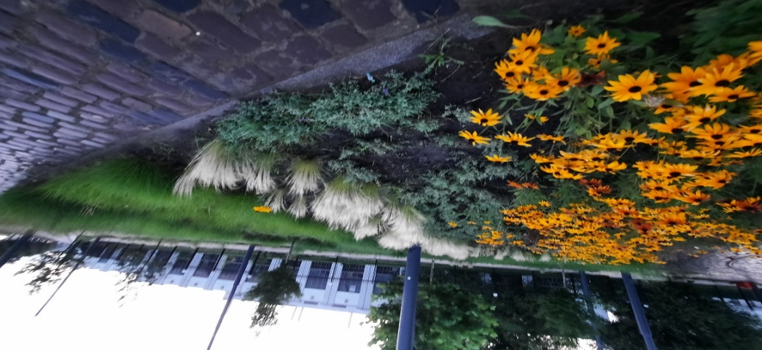
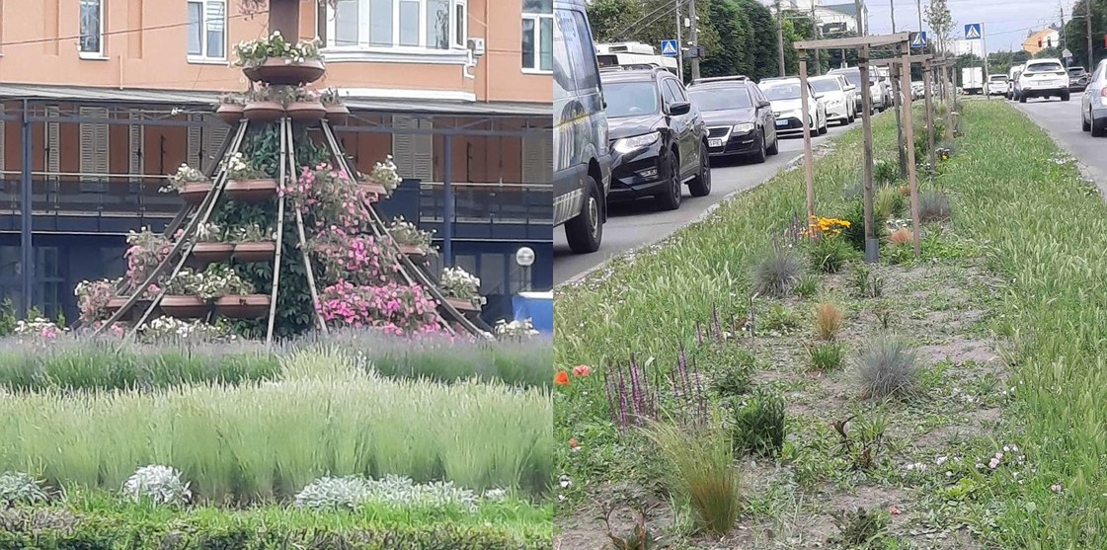
9
Planting of Rudbeckia hirta, Stipa capillata, Calamagrostis acutiflora, Briza media, Lavandula angustifolia along Horodotska Street near the railway station in Lviv.
Ornamental grasses on a traffic junction at Soborna Square in Bila Tserkva.
In Ukraine, areas with ornamental grasses in urban ecosystems are rare. Their presence is usually linked to a lack of funds for mowing lawns. However, in flowerbed and decorative design, species and varieties of grasses and perennials are increasingly being introduced, including Salvia nemorosa L. 'Compact Violet' and 'Compact Bright Rose,' Artemisia dracunculus L., Calamagrostis acutiflora 'Karl Foerster,' among others. An example of such areas can be found in the planting of Rudbeckia hirta L., Stipa capillata L., Calamagrostis acutiflora, Briza media L., Lavandula angustifolia Mill. along Horodotska Street near the railway station in Lviv . A mixture of Agropyron cristatum (L.) Gaertn., Stipa capillata L., Salvia nemorosa L. 'Compact Violet,' Festuca ovina L., Coreopsis lanceolata L., and Papaver rhoeas L. is seen on a traffic junction at Soborna Square in Bila Tserkva. Although a decade ago, annual plants dominated the flowerbeds in Bila Tserkva, they were more costly to cultivate and maintain (Ishchuk, 2012).

Slide 10
10
However, the most significant drawback of these locations is the use of red-listed plants of the Stipa L. genus, all of which are listed in the Red Data Book of Ukraine (2009). Since the utilization of species from the Red Data Book in landscaping is clearly regulated by Article 19 of the Law of Ukraine on the Red Data Book of Ukraine (as of the current revision dated August 8, 2021), where the conditions for the special use of objects from the Red Data Book of Ukraine are precisely defined. According to Article 19, "Special use (extraction, collection) of objects listed in the Red Data Book of Ukraine is carried out in exceptional cases solely for scientific and breeding purposes, including propagation, resettlement, and cultivation under artificially created conditions, as well as for population restoration with the permission of the central executive authority responsible for implementing state policy in the field of environmental protection, based on decisions of the National Commission on the Red Data Book of Ukraine, made within its competence. Special use (extraction, collection) of objects listed in the Red Data Book of Ukraine with the aim of generating profit is prohibited and is punishable by fines. At the same time, decorative nurseries, garden centers, and landscaping companies offer red-listed plants for sale. In the public space, species of the Stipa genus are planted in less favorable conditions, such as on median strips of roads with two-way traffic, where soil salinity is elevated due to winter road treatment with a mixture of salts, and air pollution levels are high. Moreover, these species are even planted under tree canopies in squares and parks."

Slide 11
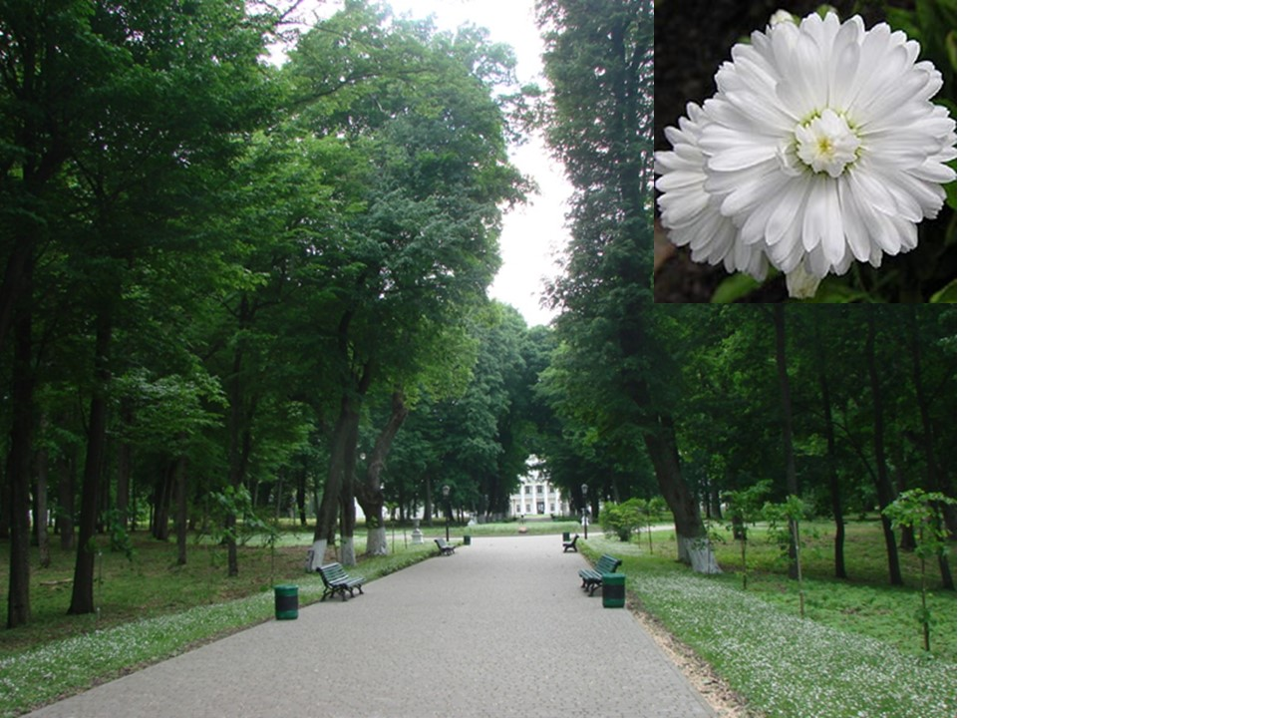
11
The foundation of Mauritian lawns in squares and parks is composed of Bellis perennis L., as seen in the historical and cultural reserve "Kachanivka" in Chernihiv Oblast.

Slide 12
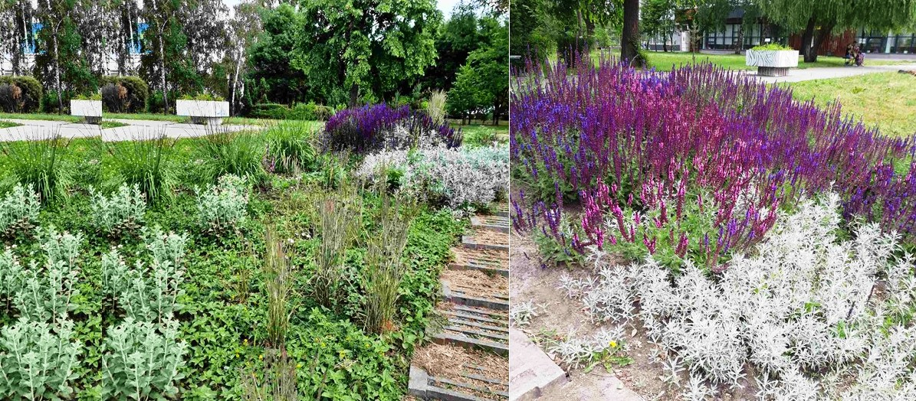
12
Mixed grass flowerbed near the monument to the victims of the Chernobyl disaster on Levanevskoho Street in Bila Tserkva.
Over the past 2-3 years, flowerbeds of native herbaceous perennials have emerged in the historic part of Bila Tserkva. For instance, on Castle Hill, Lythrum salicaria L. and Briza media L. have been planted; near the Novus supermarket, the Chernobyl disaster memorial on Levanevskoho Street, and Soborna Square, Salvia nemorosa and Artemisia dracunculus have been introduced. Currently, the use of permaculture is gaining popularity in landscape design, with one of its directions involving the integration of native ornamental grasses into urban ecosystem flowerbeds (Ishchuk, & Ishchuk, 2023)

Slide 13
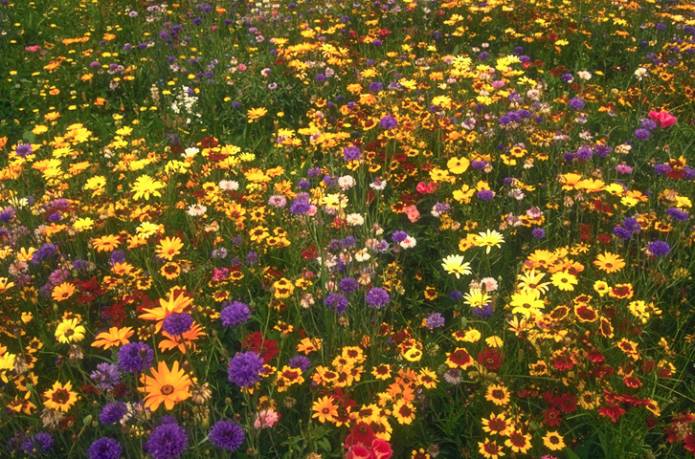
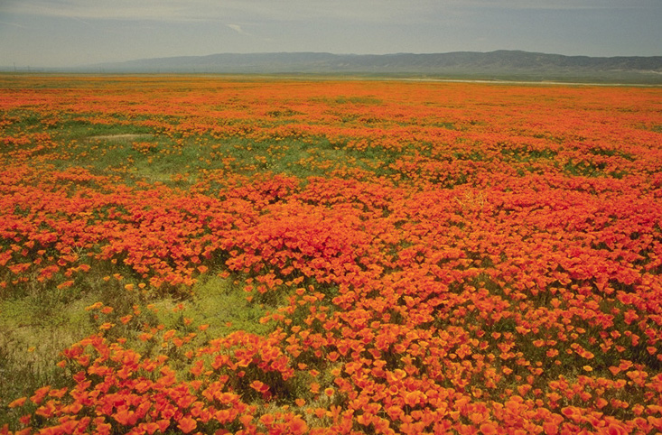
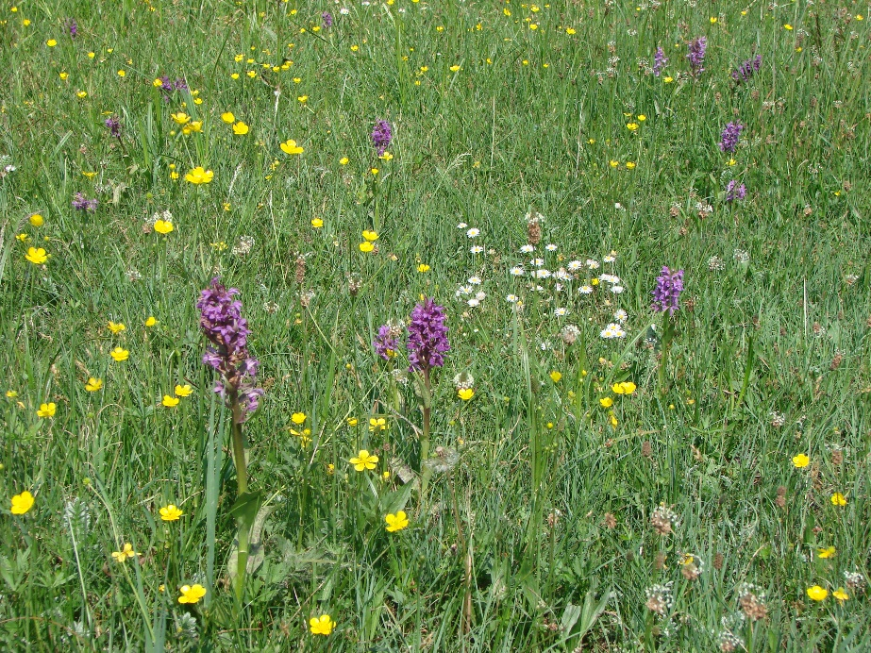
13
According to the principles of landscaping in Ukraine, flowering meadows are created by sowing or planting flowering plants on a lawn, carefully selected based on their flowering periods, which collectively create the predominant color scheme of the meadow (Kucheriavyj, 2005; Ishchuk, et al., 2014).

Slide 14
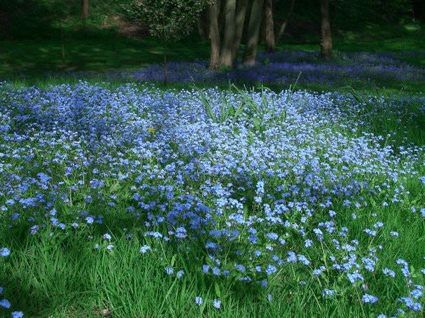
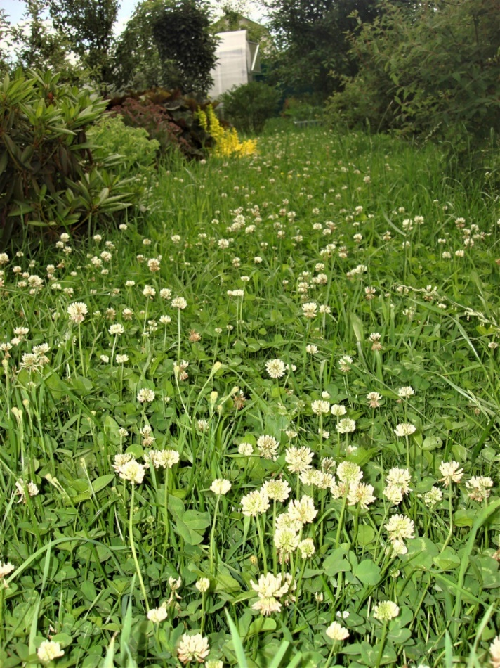
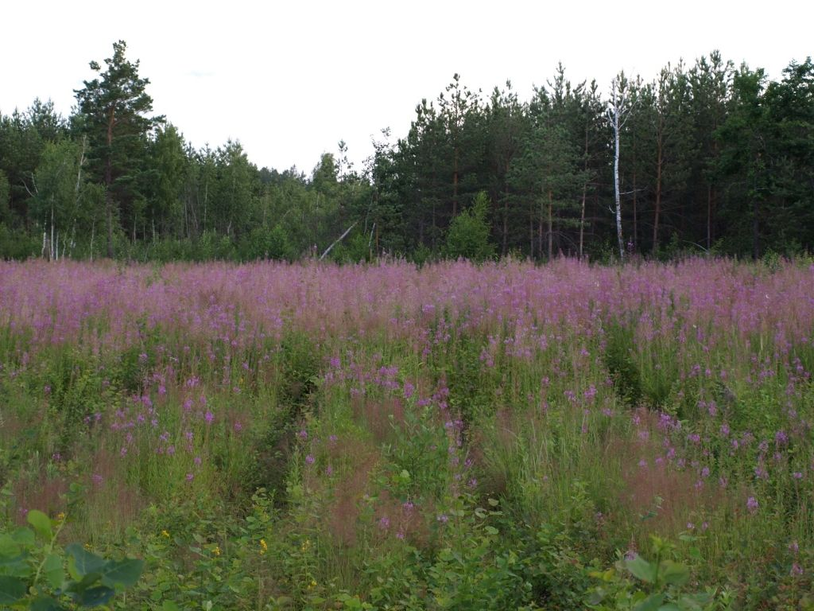
14
Flowering meadows with
Myosotis sylvatica Ehrh. ex Hoffm. Trifolium repens L. Chamaenerion angustifolium (L.) Scop.
On the other hand, flowering meadows in horticulture are considered to be large-sized, typically ranging from 500 to 2000 m² or more, and are seen as systems of equally sized groups and arrays (Kucheriavyj, 2005; Ishchuk, et al., 2014). Usually, they are composed of a single plant species, such as Matricaria chamomilla L., Phlox paniculata L., etc. To achieve a colorful effect in a meadow, vivid plants can be incorporated, but in very small quantities, evenly dispersed among the main components. For instance, next to Matricaria chamomilla L., Coreopsis grandiflora Hogg. ex Sweet or Papaver rhoeas L. could be planted to enhance the overall appearance.

Slide 15
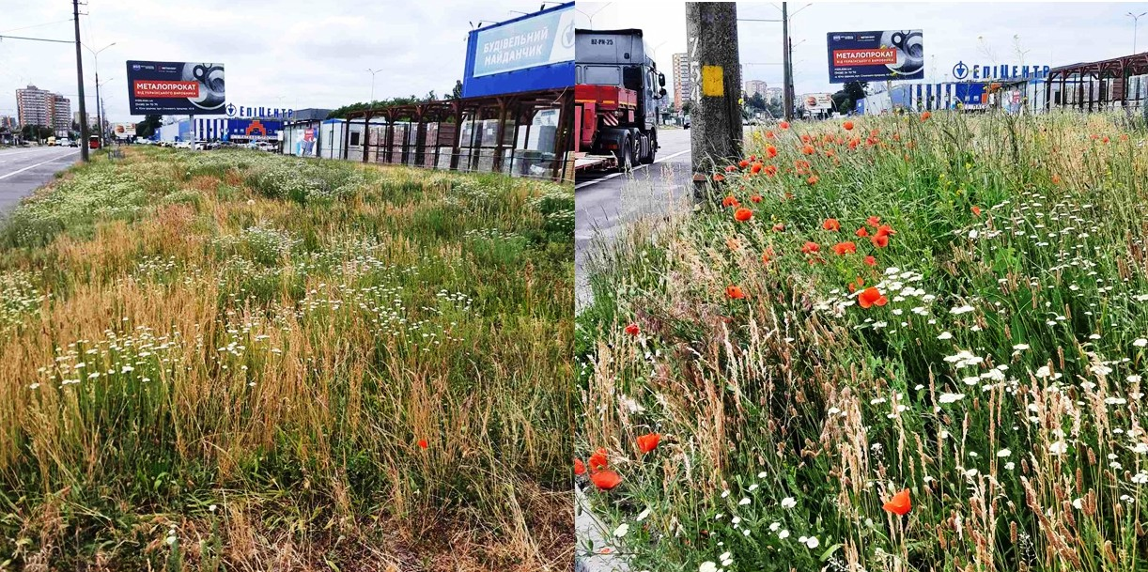
15
Test plot in Bila Tserkva where lawn has been replaced with ornamental grasses along Levanivs'koho Street near the "Epicenter" hypermarket.
In Bila Tserkva, a trial area has also been established where the lawn has been replaced with ornamental grasses on Levanevskoho Street near the EpiCentre hypermarket. The taxonomic composition of the ornamental grasses includes native species that are resilient in urban ecosystems, such as Agropyron cristatum (L.) Gaertn., Achillea millefolium L., Trifolium medium L., Plantago lanceolate L., Medicago lupulina L., Echium vulgare L., Poa trivialis L., Poa pratensis L., Poa annua L., Papaver rhoeas L., Convolvulus arvensis L.

Slide 16
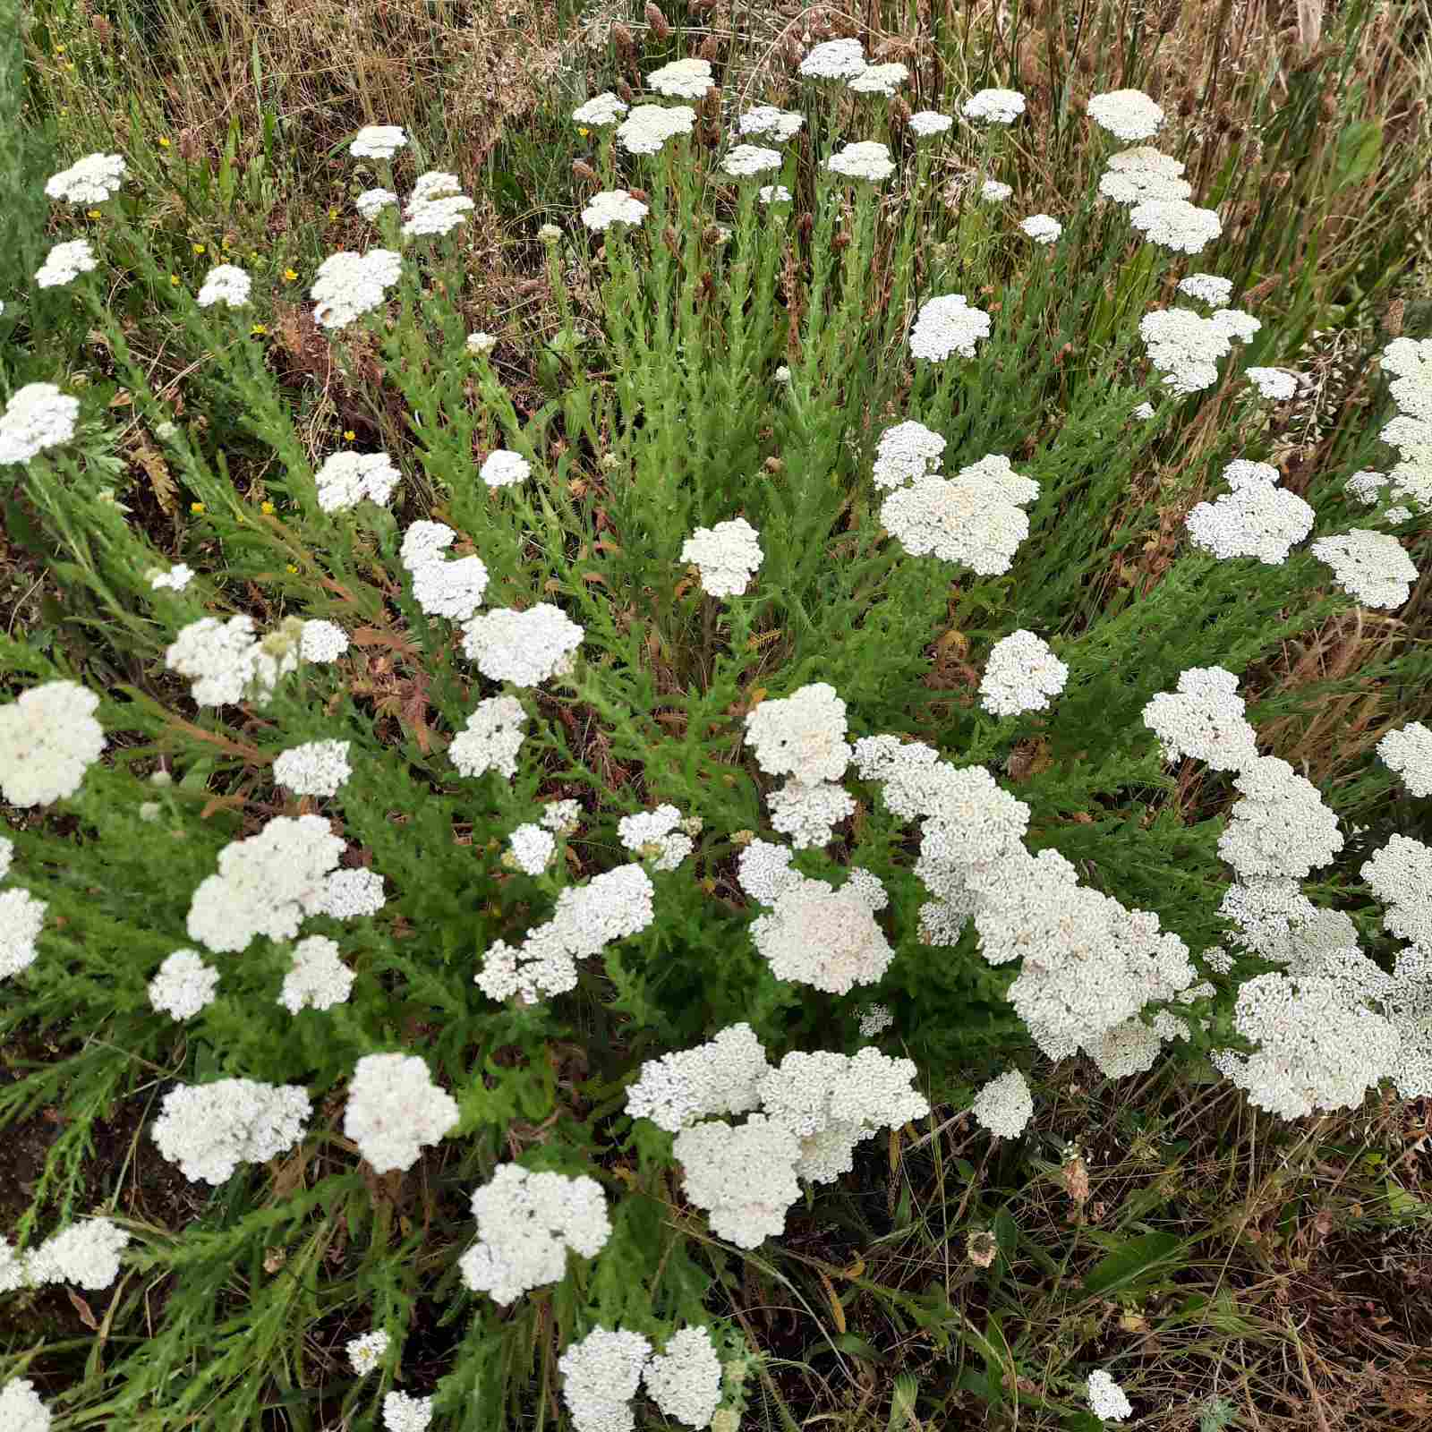
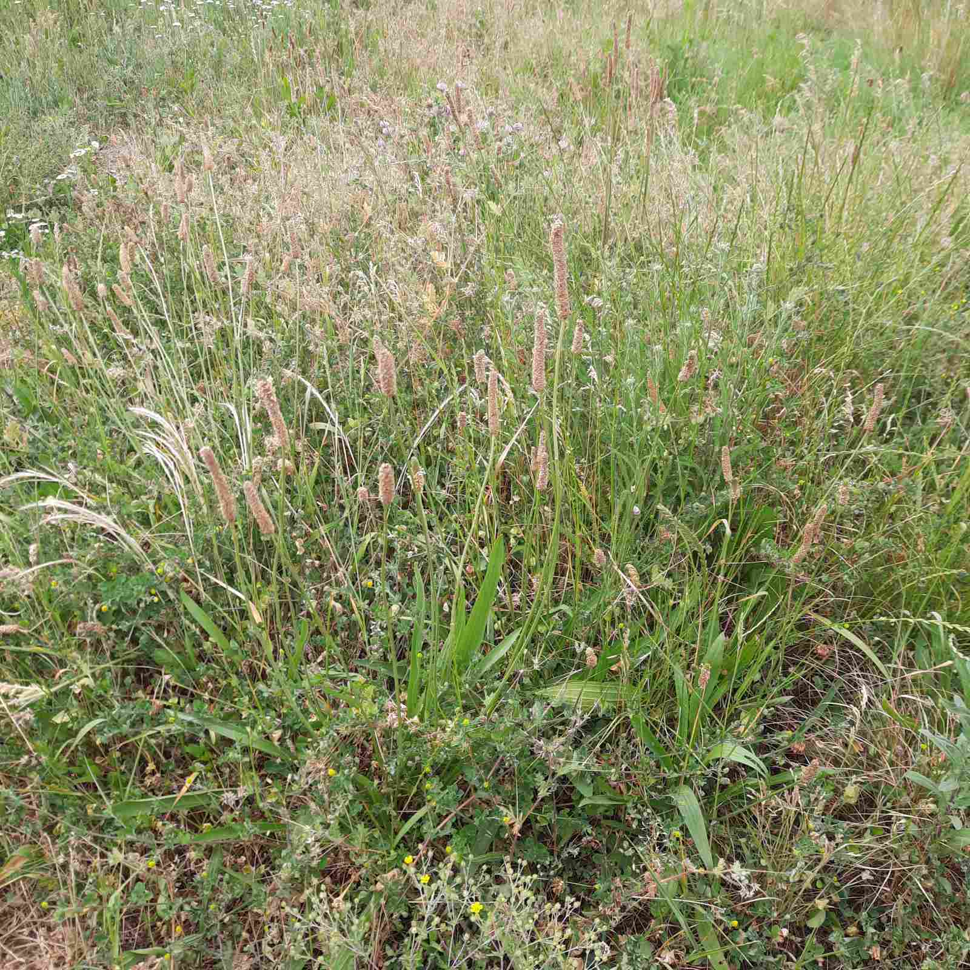
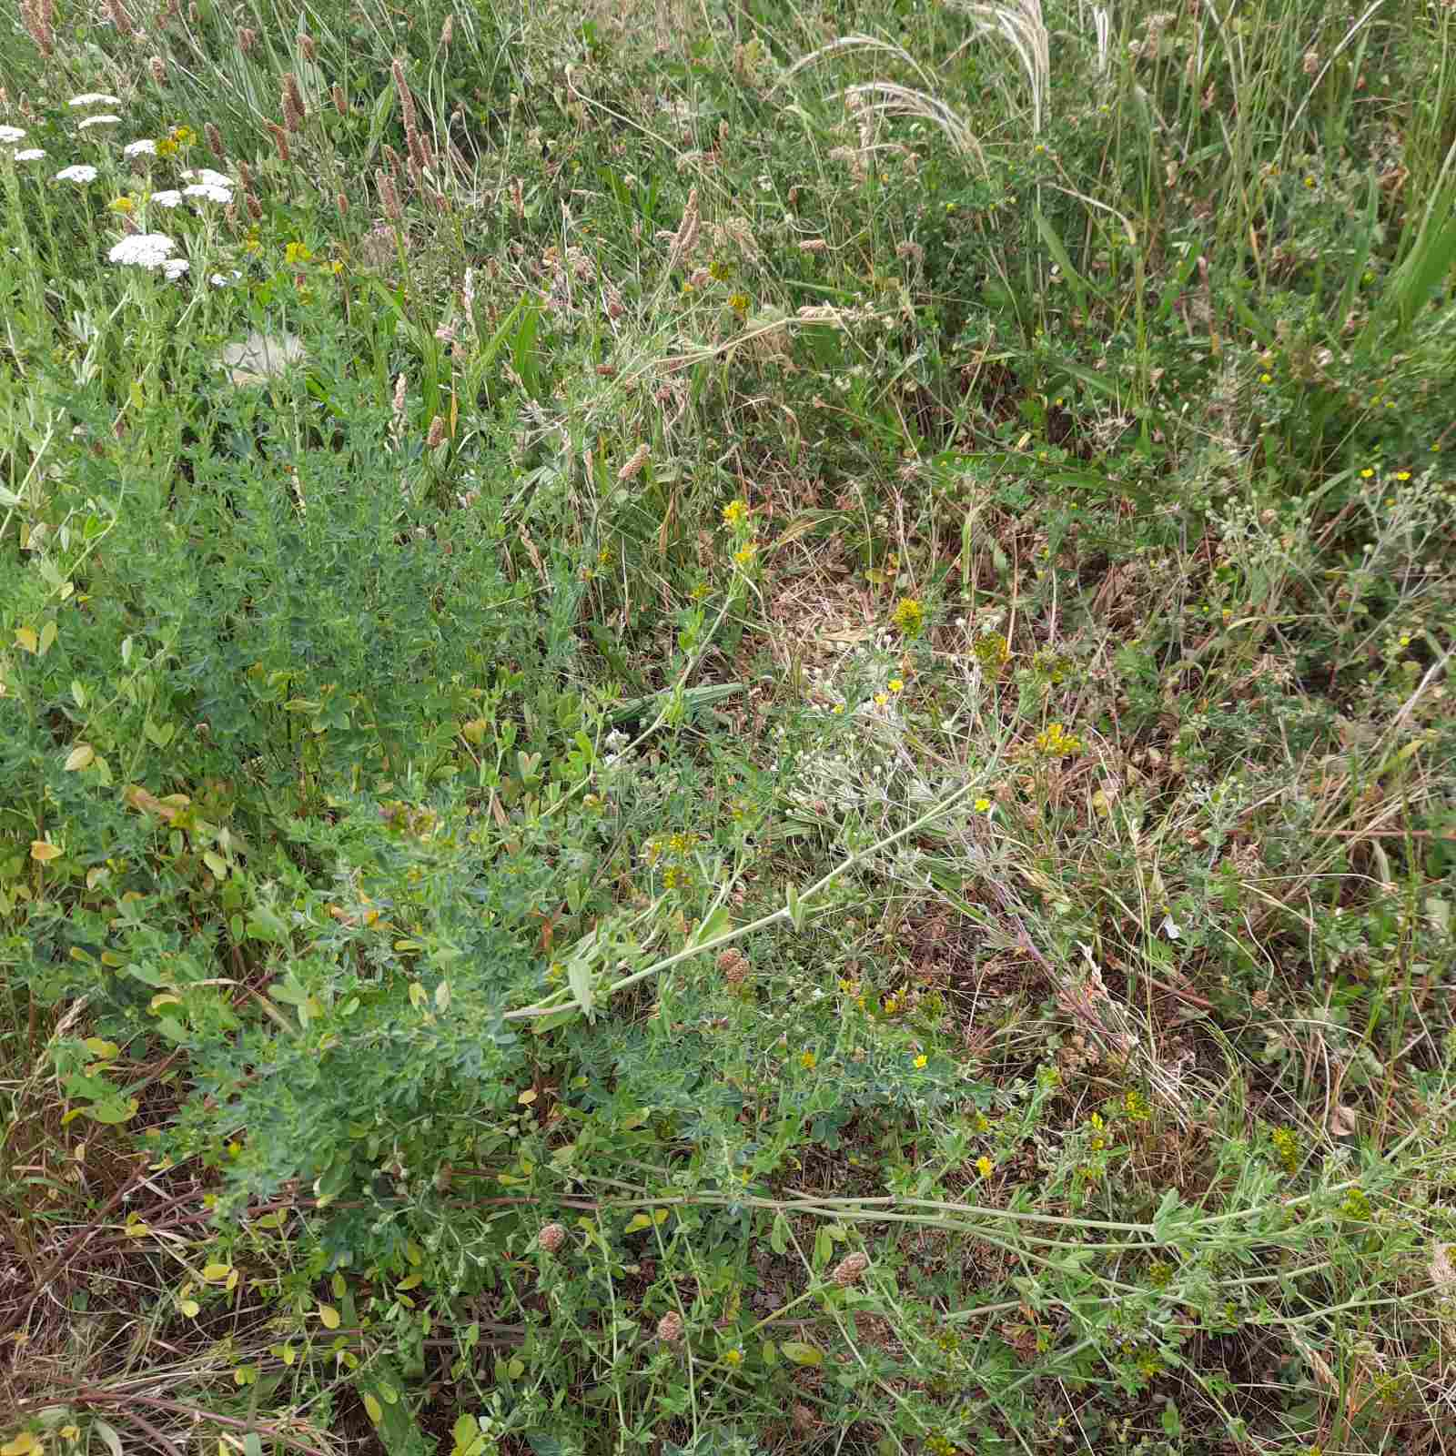
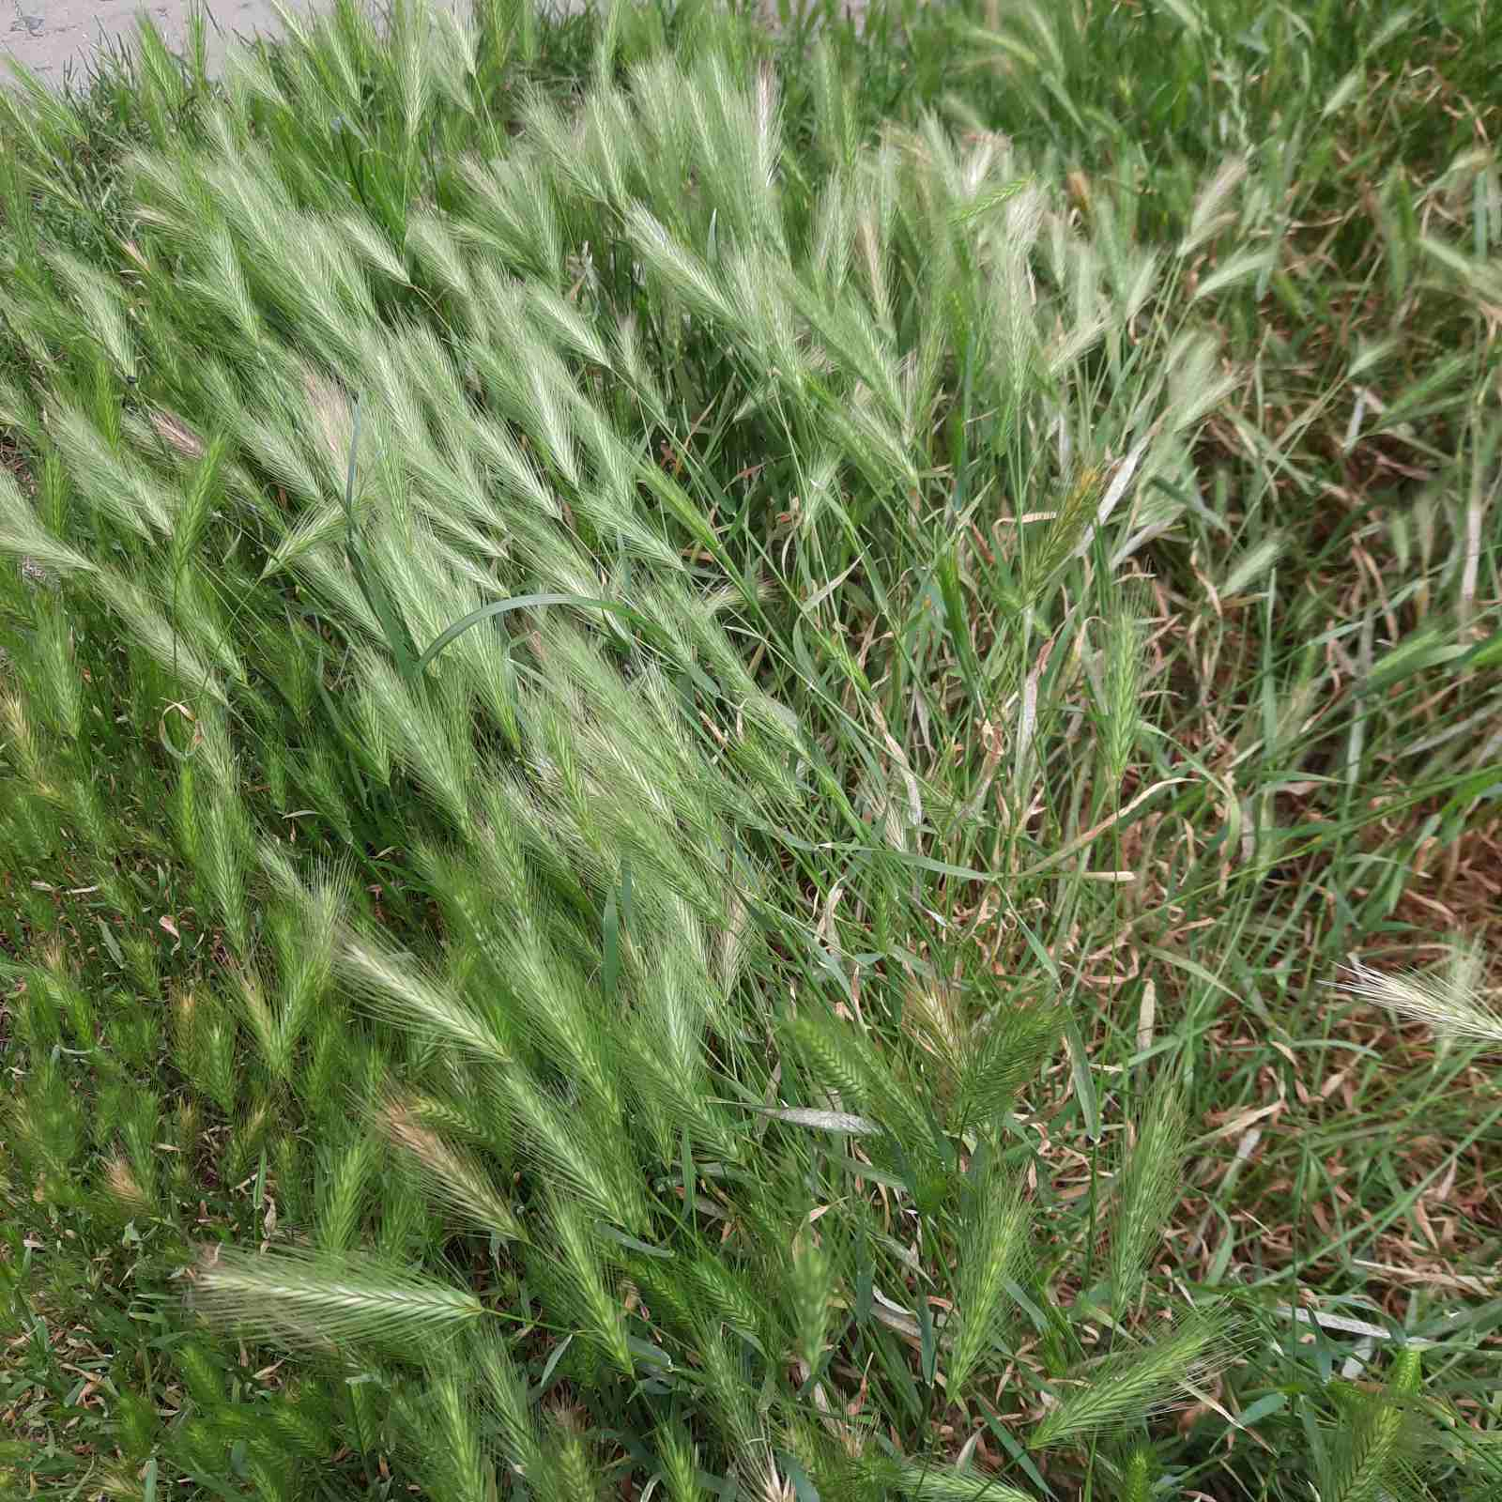
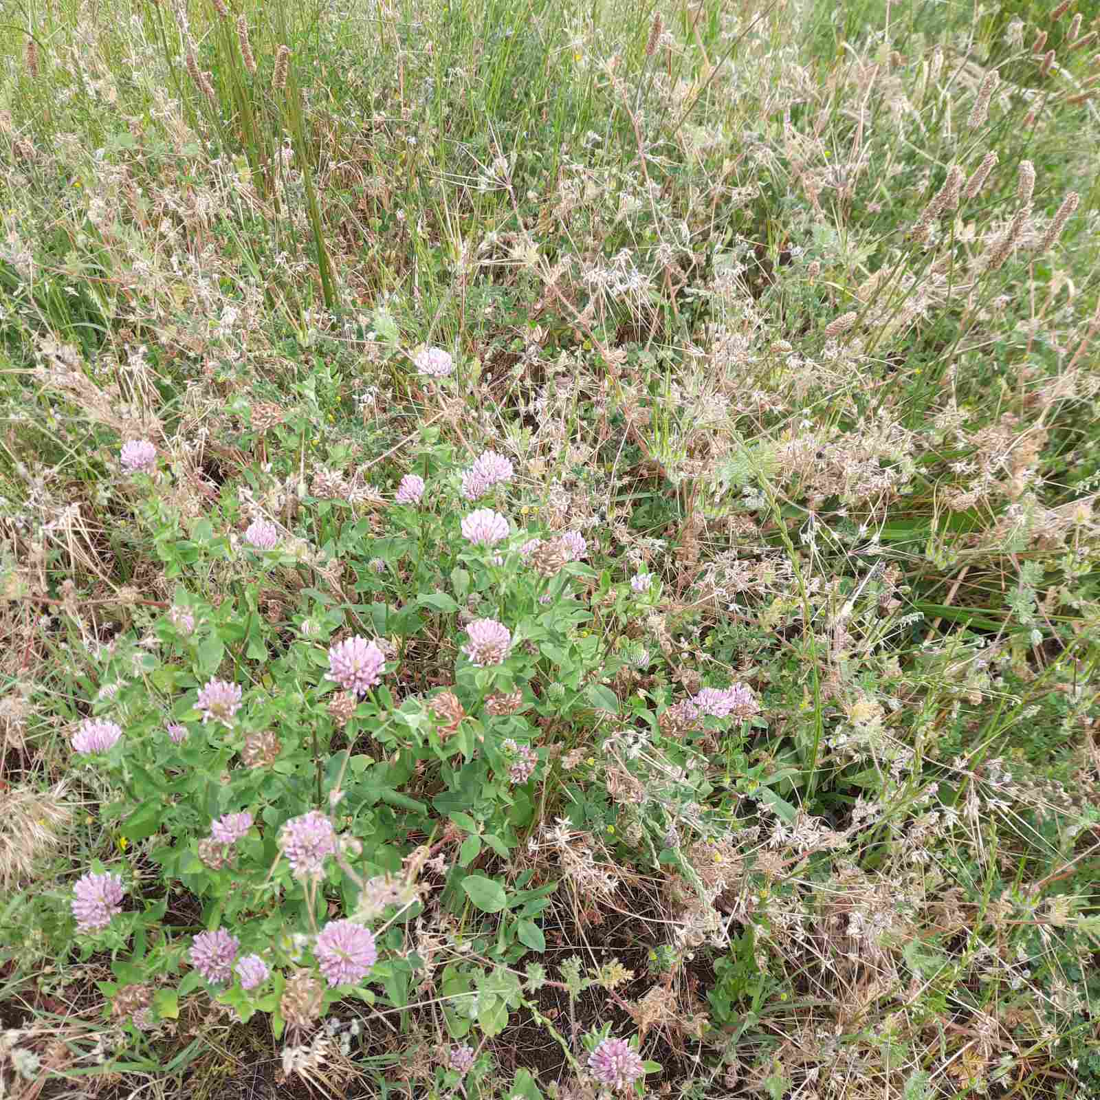
Taxonomic composition of the sample plot
ornamental grasses
16
Achillea millefolium L.
Plantago lanceolate L.
Medicago lupulina L..
Trifolium medium L.
Agropyron cristatum (L.) Gaertn.

Slide 17
17
Table 1. Taxonomic composition of herbaceous plants on the test plot with ornamental grasses in Bila Tserkva.
Species Name | Height, cm | Layer | Flower or inflorescence color | Decorative period, months
Achillea millefolium L. | 20-100 | ІІІ | white | VI-X
Agropyron cristatum (L.) Gaertn. | 20-60 | ІІ | pale green | V-VI
Cichorium intybus L. | 40-120 | ІІІ | blue | VI-ІХ
Convolvulus arvensis L. | 3-5 | І | white, pink | ІV-Х
Echium vulgare L | 30-70 | ІІІ | blue | VII-IX
Festuca rubra L. | 30-80 | IIІ | green or pink-purple | V-VI
Lotus corniculatus L. | 30-40-80 | ІІ | yellow | VI-VIII
Medicago lupulina L. | 10-50 | ІІ | yellow
Papaver rhoeas L. | 25-80 | ІІ | bright red | VI-VIII
Plantago lanceolate L. | 40-50 | І | pale brown | VII-IX
Poa trivialis L. | 20-100 | ІІІ | green-yellow | V- VI
Poa pratensis L. | 20-80 | ІІІ | salad-yellow | V- VI
Poa annua L. | 5-35 | І | pale green | VI-ІX
Trifolium medium L. | 20-50 | ІІ | bright red | V-VI

Slide 18
18
Thus, on the trial plot, we identified 14 species of native plants, 10% of which belong to the Poaceae family. If we do not pay particular attention to weeding, this flowering meadow will develop naturally: wild species will migrate, and the strongest species from the seed mixture will begin to dominate over the weaker ones. However, the lifespan of these "meadows" can be extended if we control natural competition and spread through regular weeding. When selecting plants from ornamental grasses, it's important to avoid using invasive species.

Slide 19
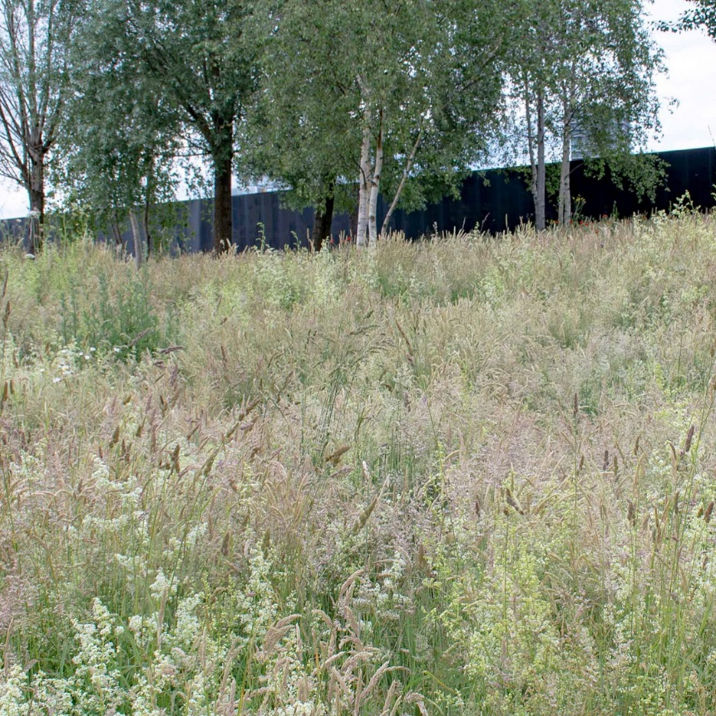
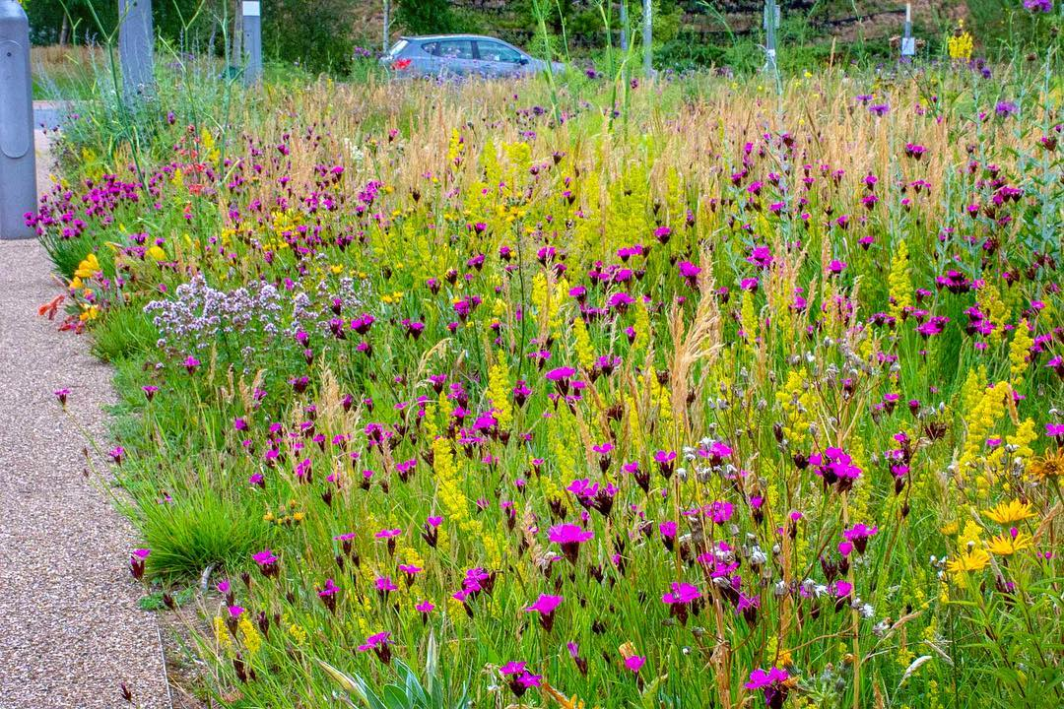
19
The advantage of medium-height plantings is the result of a compromise between the increased aesthetic value of taller, more natural vegetation, which holds significant importance for biodiversity, and concerns that high vegetation might appear "unkempt," showing signs of neglect and potentially becoming a fire safety issue in the latter half of the year – during autumn.

Slide 20
20
CONCLUSIONS
Thanks to its well-developed root system, ornamental grasses retain twice as much water, reducing the dependence on manual watering both during flood periods and droughts. Ornamental grasses consume less water and do not require frequent irrigation. The height advantage of ornamental grasses over lawns allows for better absorption of dust and harmful substances, which could potentially form smog, and also helps to lower the air temperature. Meadow grasses contribute to the preservation and propagation of small mammals and pollinating insects. Proper zoning using ornamental grasses enhances the appearance and naturalizes any landscape. Experimental ornamental grass areas for educational purposes can be established near educational institutions and cultural sites.

Slide 21
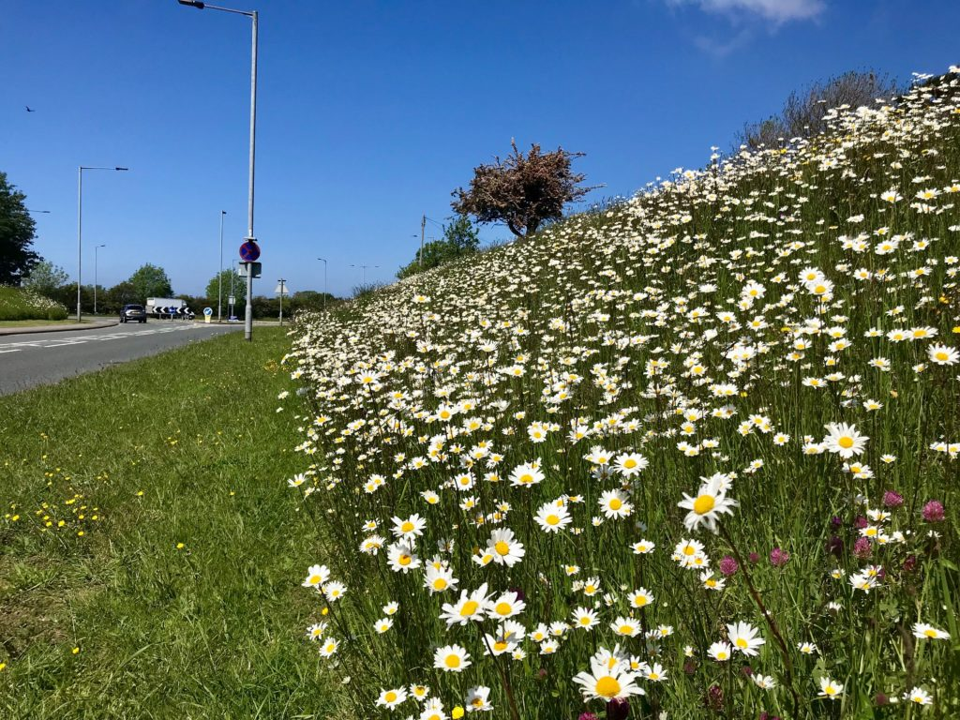
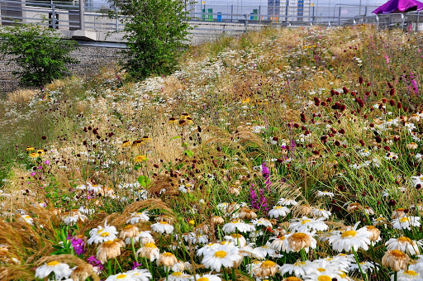
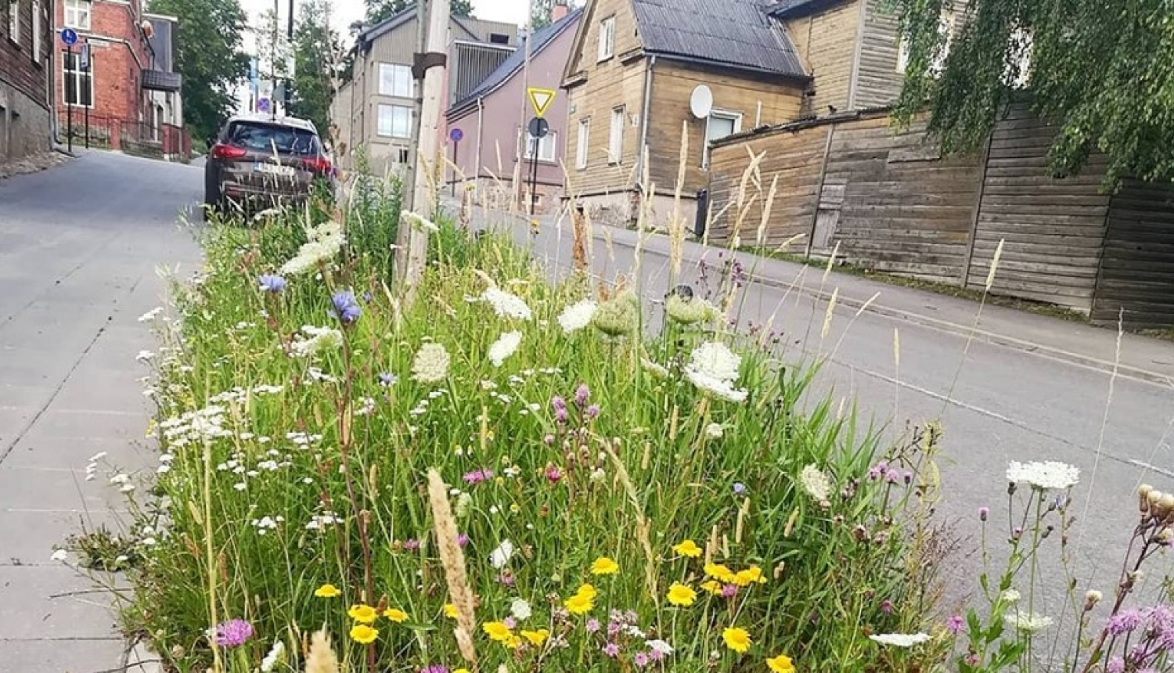
21
Thank you for your attention!

